Slide 1
Next Up:
Anh Tran

Slide 2
3
3

Slide 3
2

Slide 4
1

Slide 5


Leveraging ImportExcel & PowerShell for Business Insights . Anh Tran

Slide 6

Many thanks to our sponsors:

Slide 7


About Me
Automation, Data Analytics
Blog: https://analysiswithanh.medium.com
Linkedin: https://www.linkedin.com/in/anh-tran-thi-lan

Slide 8

Agenda
Business Problem
Case Study 1: Estimation
Data Preparation
Case Study 2: Forecast
Automate the Workflow

Slide 9
Expectation
Problems are real
Data is simulated
The flow of the code is customized for this session
Bugs will be intentionally introduced in the script so we will fix together

Slide 10

Business Problem
Visibility
Operation
Inventory
Utilization
Forecast
Estimation
Automation
Business Problem | Estimation | Data Preparation | Forecast | Automate Workflow | Summary

Slide 11
“I choose a lazy person to do a hard job. Because a lazy person will find an easy way to do it.”
― Bill Gates
Business Problem | Estimation | Data Preparation | Forecast | Automate Workflow | Summary

Slide 12

Estimation
Estimation is the process of finding an approximate value that is usable despite incomplete, uncertain, or unstable input data.
Visibility
Operation
Inventory
Utilization
Forecast
Estimation
Automation
Business Problem | Estimation | Data Preparation | Forecast | Automate Workflow | Summary

Slide 13
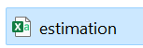
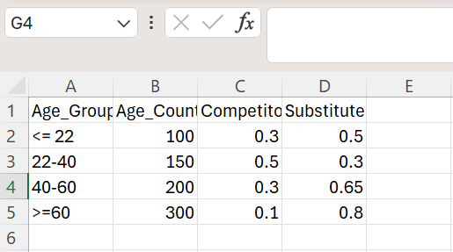
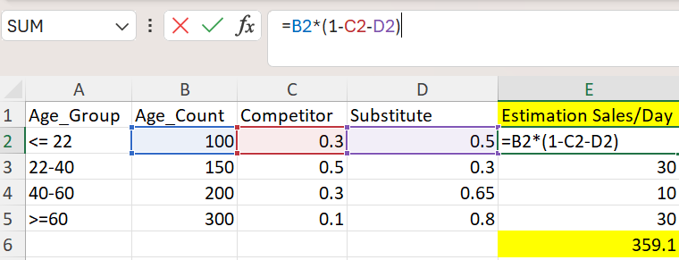
Estimation
BEFORE
AFTER
Business Problem | Estimation | Data Preparation | Forecast | Automate Workflow | Summary

Slide 14


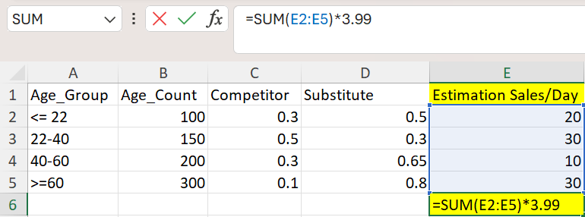

Estimation
Input data
Auto size and Color
Formulars
Business Problem | Estimation | Data Preparation | Forecast | Automate Workflow | Summary

Slide 15
Demos
We love Demos!

Slide 16

Data Preparation
Different Formats
Calculation
Data Quality Check
Keep calm, drink coffee and troubleshoot
Business Problem | Estimation | Data Preparation | Forecast | Automate Workflow | Summary

Slide 17
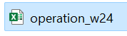
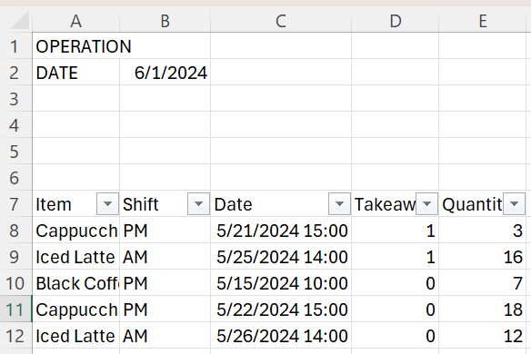
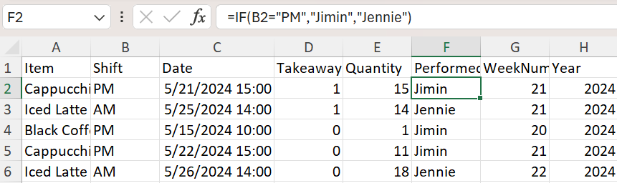
Operation
BEFORE
AFTER
Remove not useful info
Formulars
Business Problem | Estimation | Data Preparation | Forecast | Automate Workflow | Summary

Slide 18
Demos
We love Demos!

Slide 19
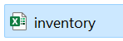
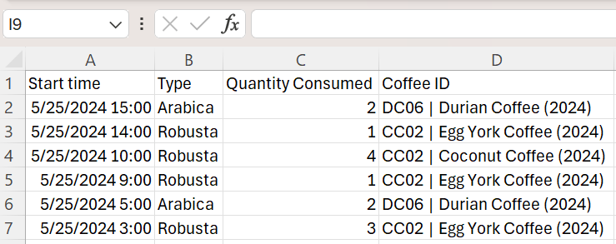
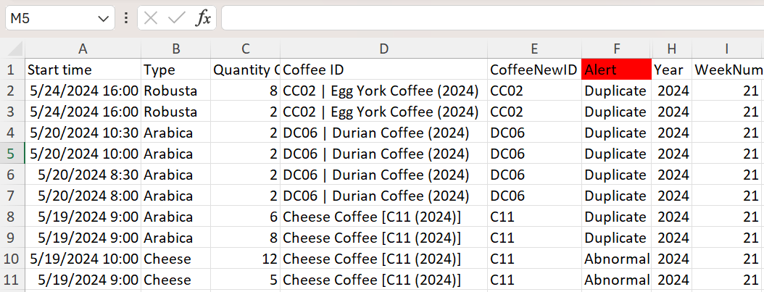
Inventory
BEFORE
Alert on Input Errors
AFTER
Get the right Coffee IDs
Get Weeks, Years info
Business Problem | Estimation | Data Preparation | Forecast | Automate Workflow | Summary

Slide 20
Demos
We love Demos!

Slide 21

Utilization
Visibility
Operation
Inventory
Utilization
Forecast
Estimation
Automation
Business Problem | Estimation | Data Preparation | Forecast | Automate Workflow | Summary

Slide 22
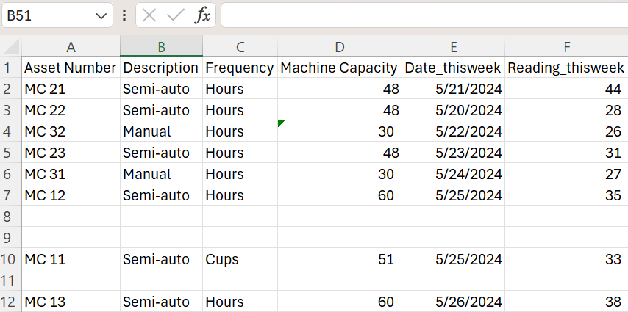
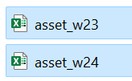
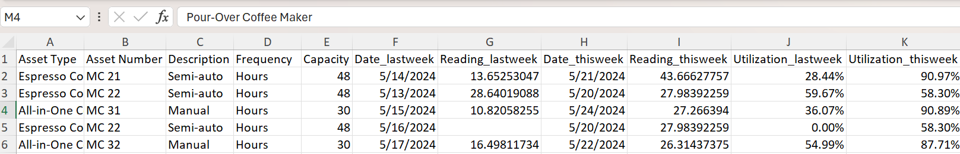
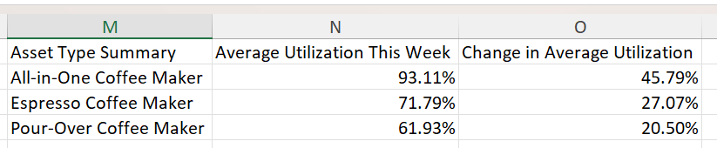
Utilization
Remove blanks
BEFORE
Retain only relevant info
AFTER
Business Problem | Estimation | Data Preparation | Forecast | Automate Workflow | Summary

Slide 23


Utilization
AFTER
Add info from 2 files
Formulars
Unique Asset Type
Business Problem | Estimation | Data Preparation | Forecast | Automate Workflow | Summary

Slide 24
Demos
We love Demos!

Slide 25
Forecast
Trend
Seasonality
Residual
Time
Business Problem | Estimation | Data Preparation | Forecast | Automate Workflow | Summary
Notes:
Trend: change direction over a period of time
Seasonality: seasonality is about periodic behavior, spikes or drops caused by different factors
Residual: irregular fluctuations that we cannot predict using trend or seasonality

Slide 26
Forecast
Statistical functions
Moving Average
Weighted Moving Average
Exponential Smoothing (ETS) algorithm
Business Problem | Estimation | Data Preparation | Forecast | Automate Workflow | Summary
Notes:
calculate values related to statistical distributions and probability. Statistical functions are primarily used to mathematically process a specified set of cells in a worksheet

Slide 27
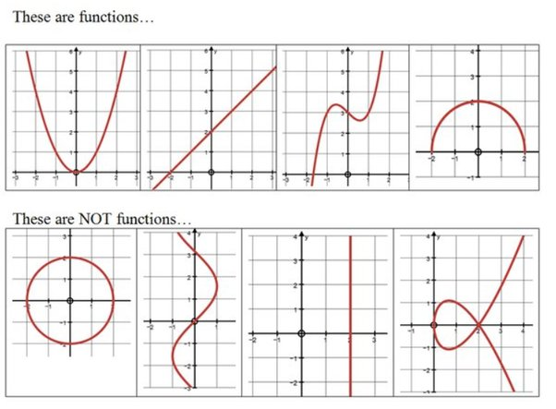
Forecast
Business Problem | Estimation | Data Preparation | Forecast | Automate Workflow | Summary

Slide 28
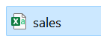
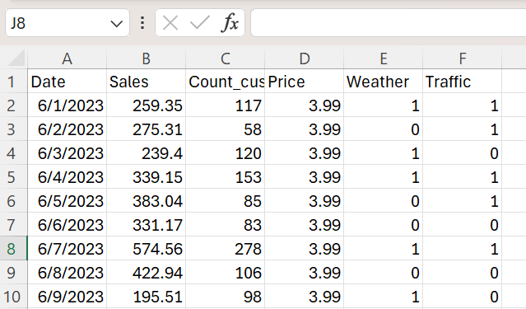
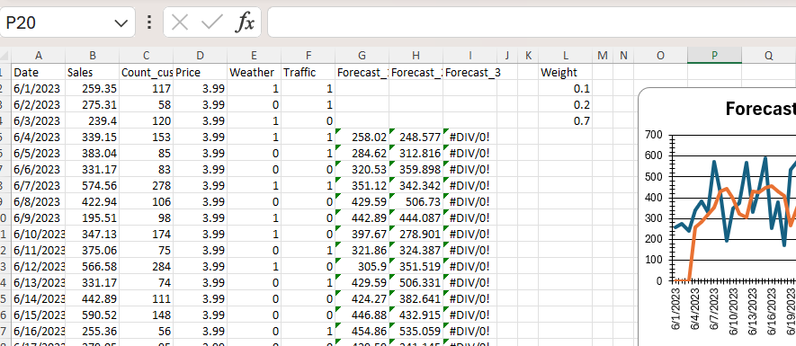
Forecast
BEFORE
AFTER
Forecast Formulars
Weight Input
Forecast Charts
Business Problem | Estimation | Data Preparation | Forecast | Automate Workflow | Summary

Slide 29
Demos
We love Demos!

Slide 30
Enhancement
Object Oriented Programming
Dot
Dynamic range
Business Problem | Estimation | Data Preparation | Forecast | Automate Workflow | Summary

Slide 31



Slide 32
Automate the Workflow
Azure Logic Apps simplifies the way that you connect legacy, modern, and cutting-edge systems across cloud, on premises, and hybrid environments
Many other services that provide similar capabilities: Power Automate, Functions, and WebJobs
You don't have to choose just one of these services. They integrate with each other and with external services
Business Problem | Estimation | Data Preparation | Forecast | Automate Workflow | Summary

Slide 33
Demos
We love Demos!

Slide 34
Summary
Business Problem | Estimation | Data Preparation | Forecast | Automate Workflow | Summary

Slide 35

Thank you

Slide 36
Q&A
15 minutes

